Slide 1


Pathways to trauma specific care – local context
Part 1 - Family Hubs
An opportunity for Nottingham Children’s Partnership
Produced in conjunction with:-
Julia Bramble
Early Help & Family Hubs Service Manager
Veronica (Ronnie) Fairley
Supporting Families Programme Lead
Paul Martin
Reducing Parental Conflict Lead
ed

Slide 2





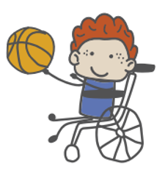
Whole family support
Data maturity
Early Help System Guide
Impact on children & young people
Family Hubs
For families with children aged 0-19 (0-25 for SEND)
“A vision for the 1001 critical days”
Supporting Families Programme
Reducing Parental Conflict
Start for Life
Access
Connections
Relations
Notes:
ACCESS S
Single access point – clear virtual offering
Beyond 0-5 offer
Outreach – to engage harder to reach families
Family friendly culture
Accessabilty & equality across protected characteristics
CONNECTION:
Co-location of staff
Not just LA – emphasis on joining up with third sector/community
Joint governance/commissioning
Evaluation on impact
Data sharing
Case management for whole family with common assessment.
Whilst focus on universal services at lower end – clear escalation process.
RELATIONSHIPS
Relationship practice – model – strengths based
Training & Development of multi-agency workforce in whole family working

Slide 3
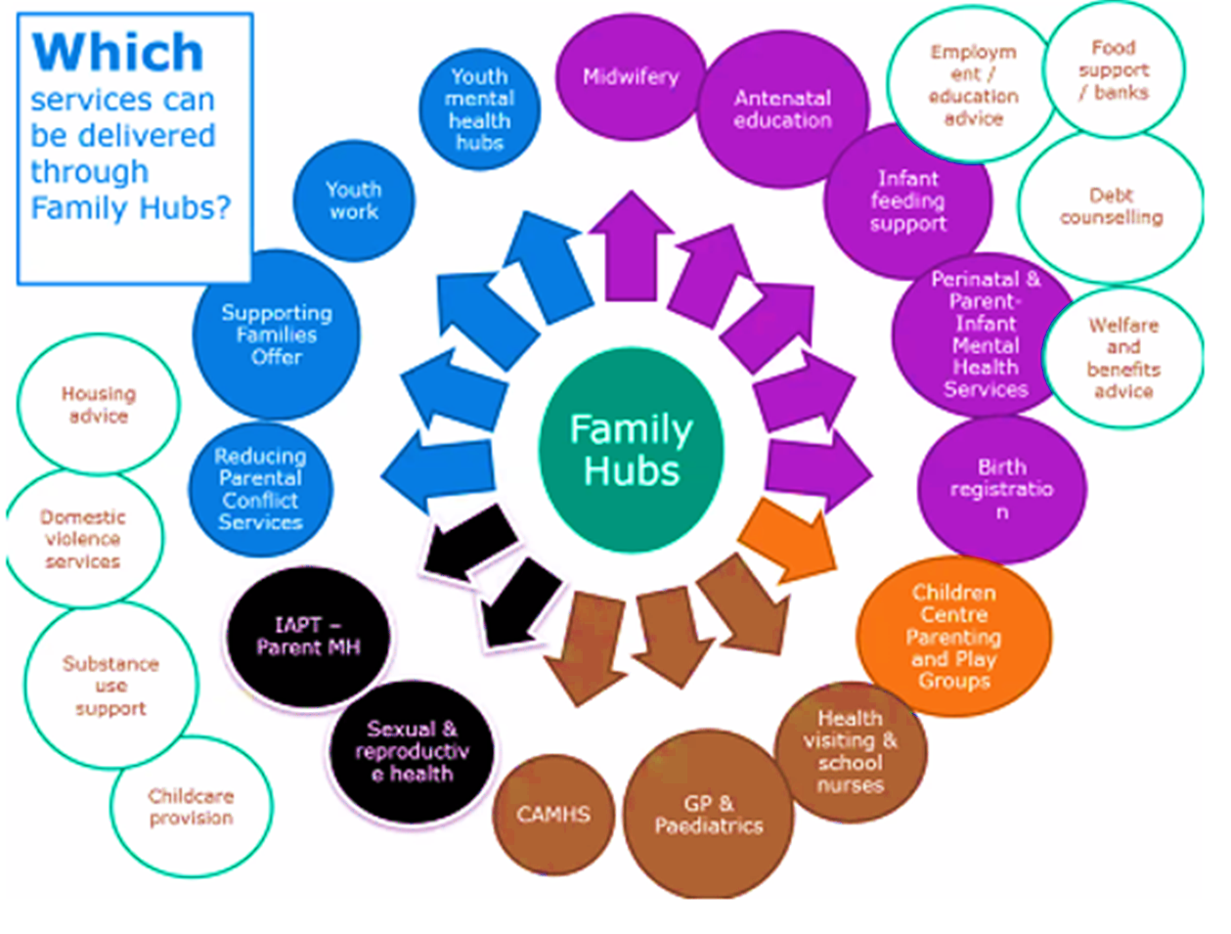

Slide 4


Solihull Approach Multi Users Licence Courses
Produced by:
Julia Bramble - Early Help Service Manager
Veronica (Ronnie) Fairley - Supporting Families Lead
Paul Martin – Reducing Parental Conflict Lead

Slide 5

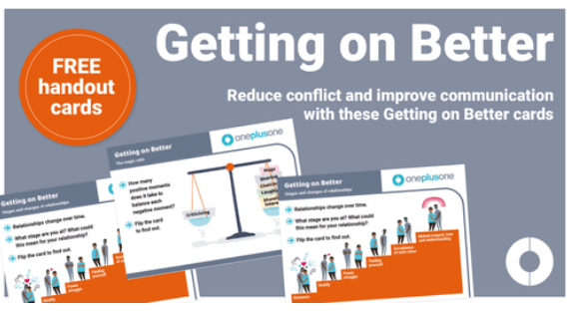
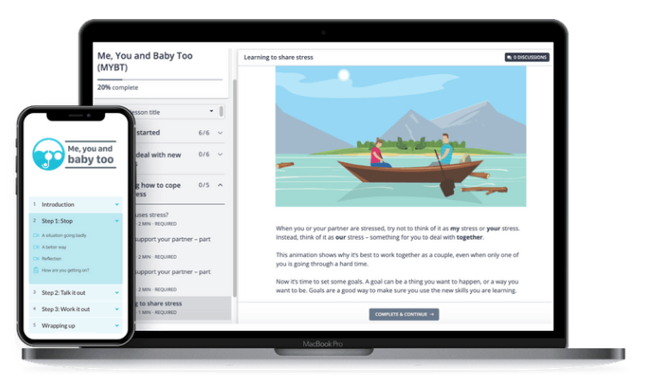
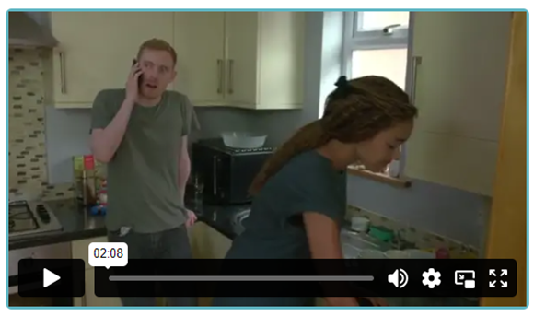
OnePlusOne – Digital Resources

Slide 6

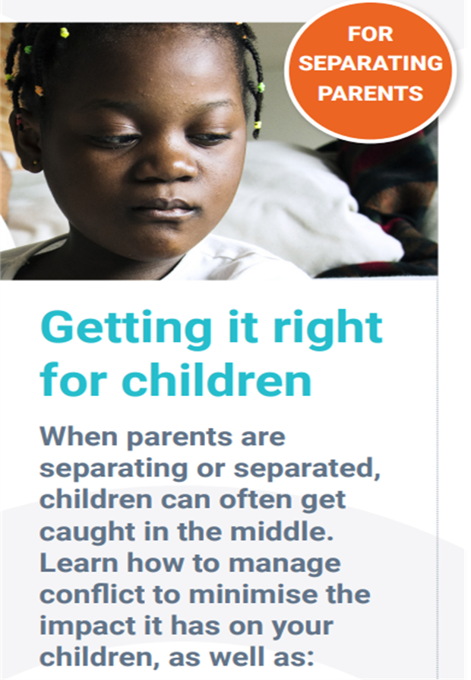

What are the OnePlusOne resources? Three separate digital resources

Slide 7
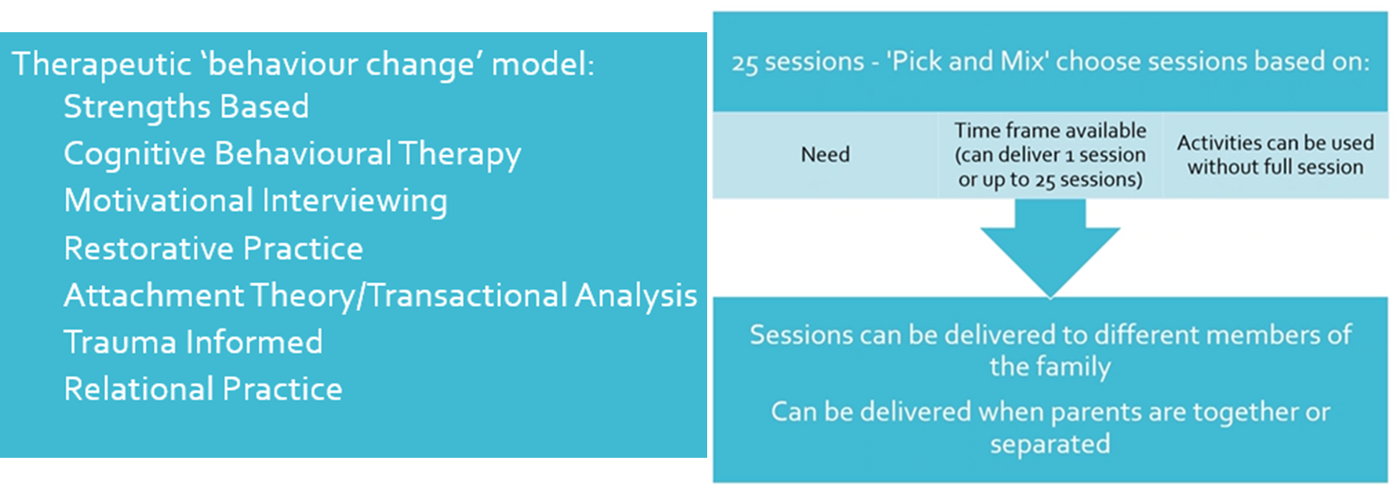
Programmes2Change - UP2U Family Practice model

Slide 8
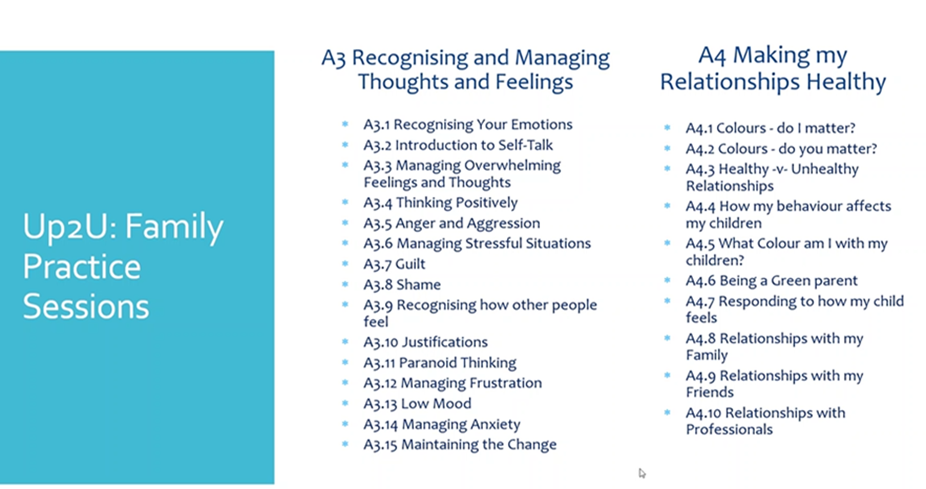
UP2U Family Practice - 25 x sessions:-

Slide 9


Therapeutic Parenting
Four-day Practitioner training facilitated by
Therapeutic Parenting Practitioner, Coach and Trainer Helen Fearn and Dr Ben Webb
Aims of the training:
Understand the impact of Developmental Trauma, Blocked Trust, associated conditions, and complex behaviours and increase Knowledge of neurobiological changes in the developing brain of young people.
Be able to use and model Therapeutic Parenting and PACE (more info click here), including the Neurosequential Model (more info click here ) when supporting families with complex trauma in order to reduce family conflict.
Use knowledge of adolescent brain development to understand the behaviour and nurture the emotional wellbeing of teenagers.
Understand the impact of trauma on parents, carers and ourselves including Secondary Trauma, Blocked Care and Compassion Fatigue.
Use practical diet and lifestyle strategies to support self-care, brain health and wellbeing.

Slide 10
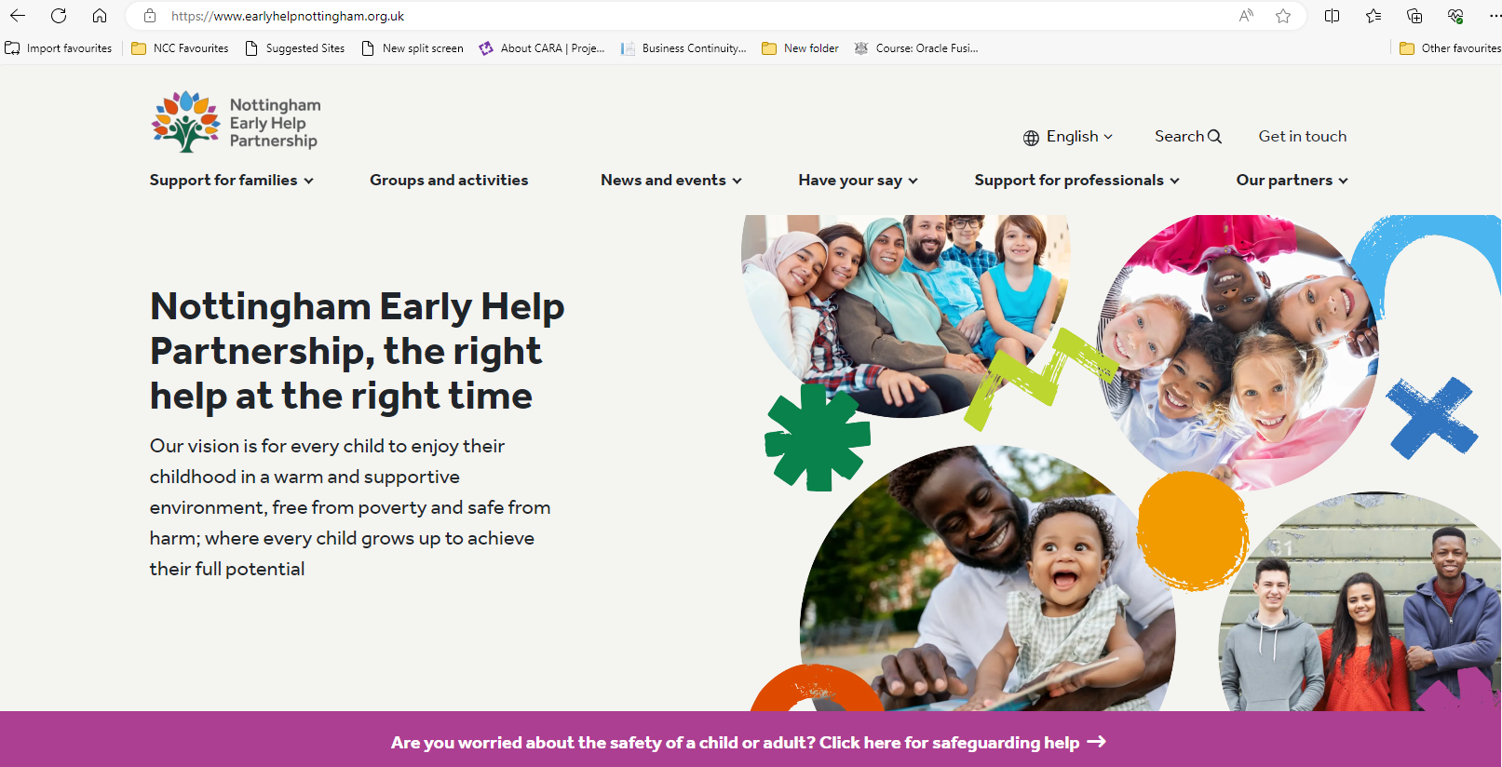

Slide 11
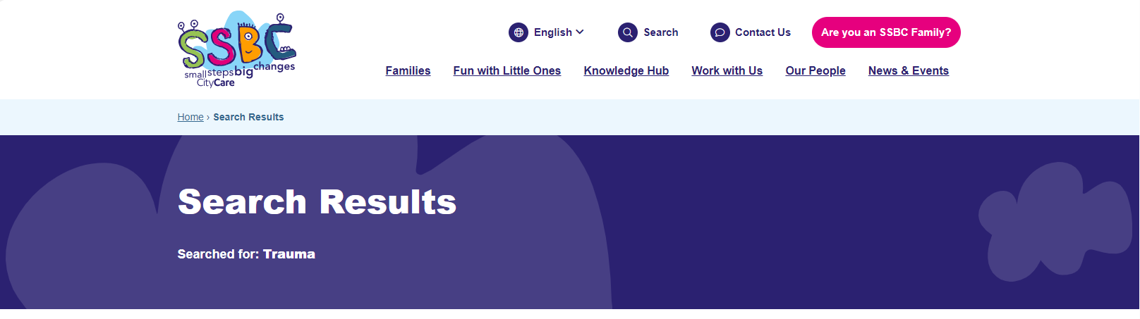
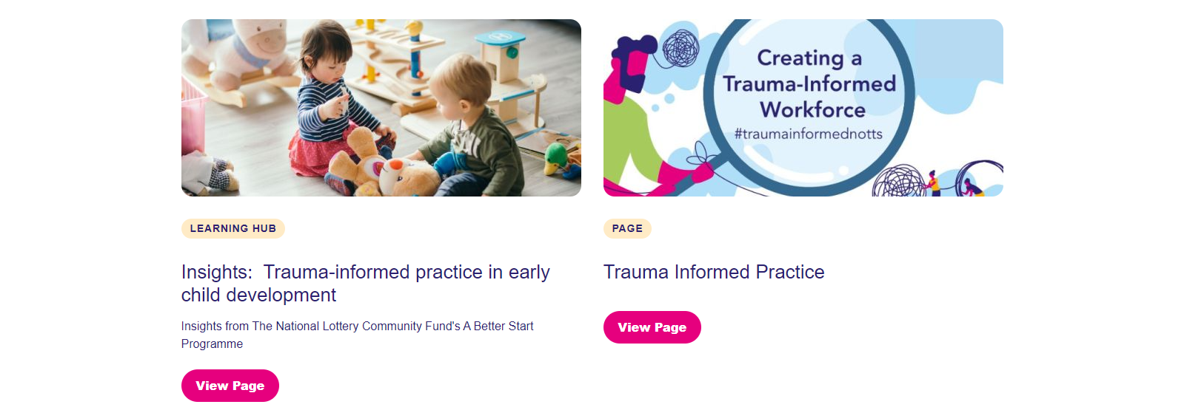

Slide 12
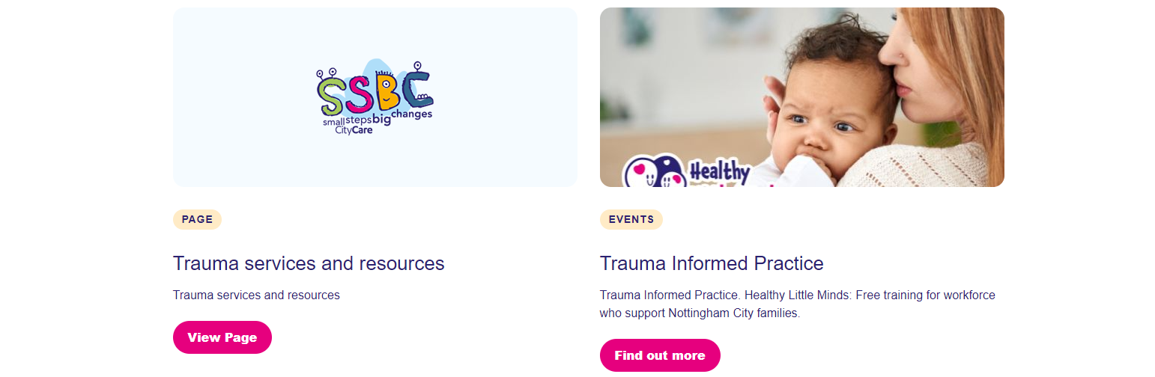
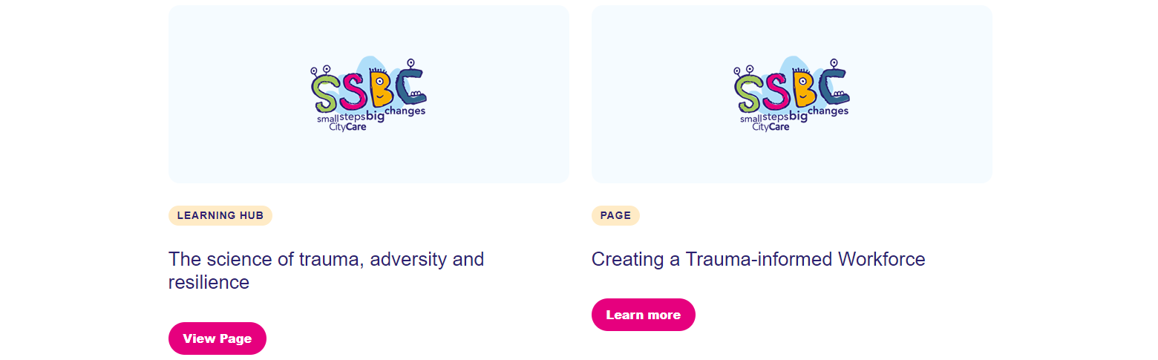

Slide 13
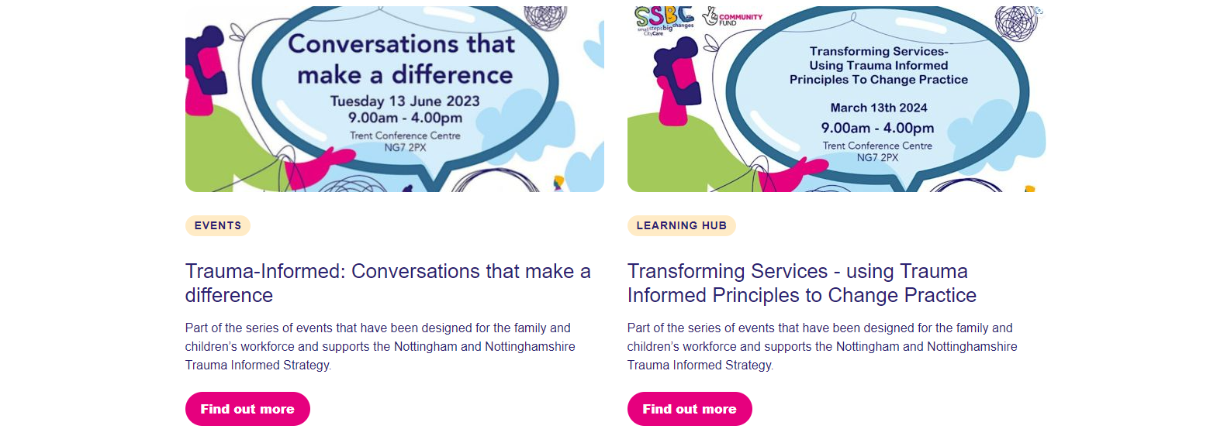
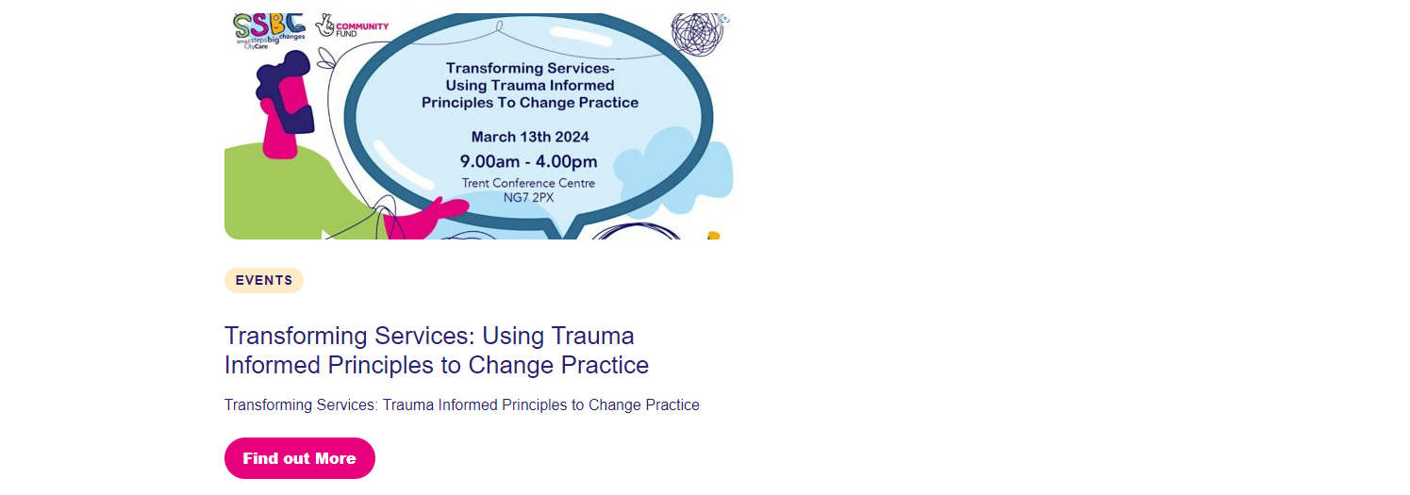

Slide 14
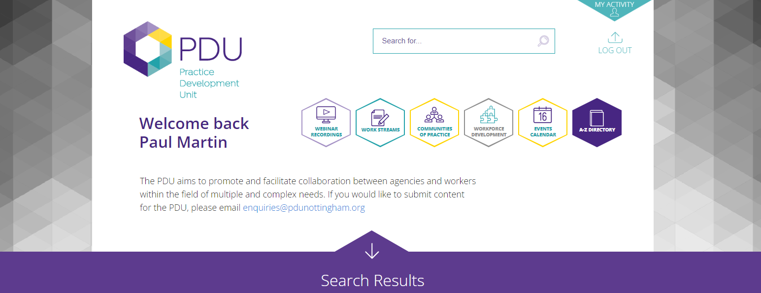
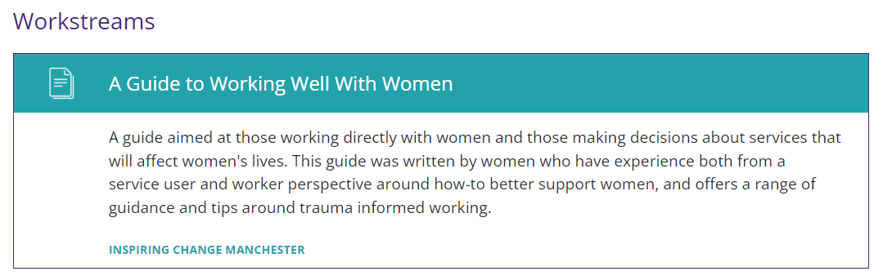

Slide 15
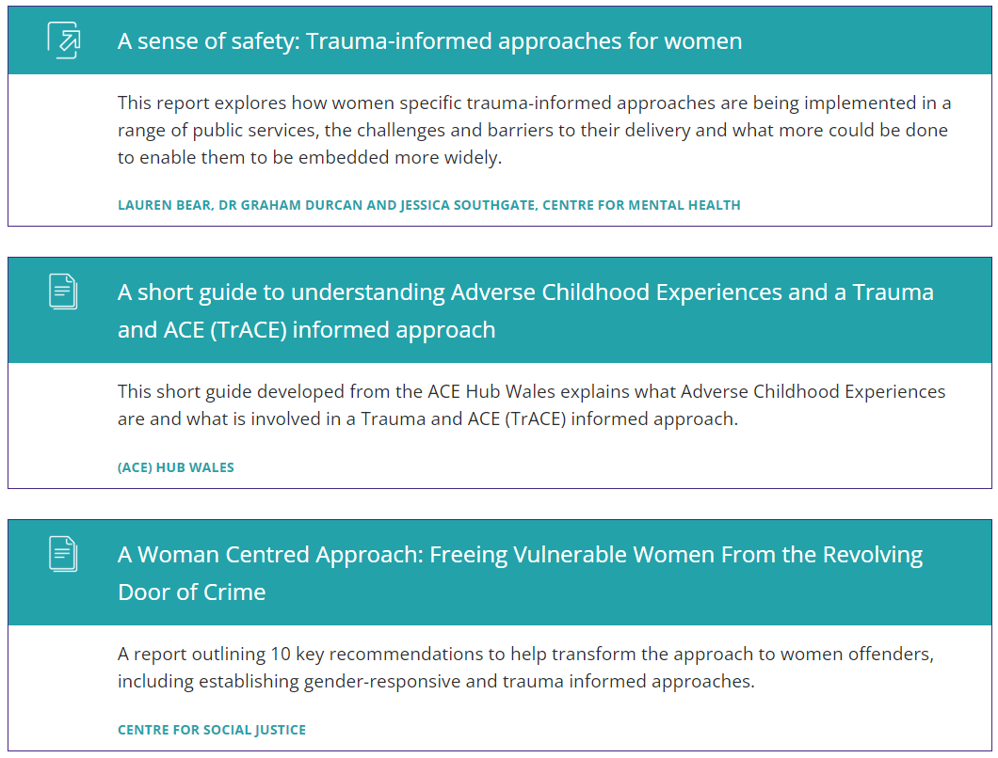

Slide 16
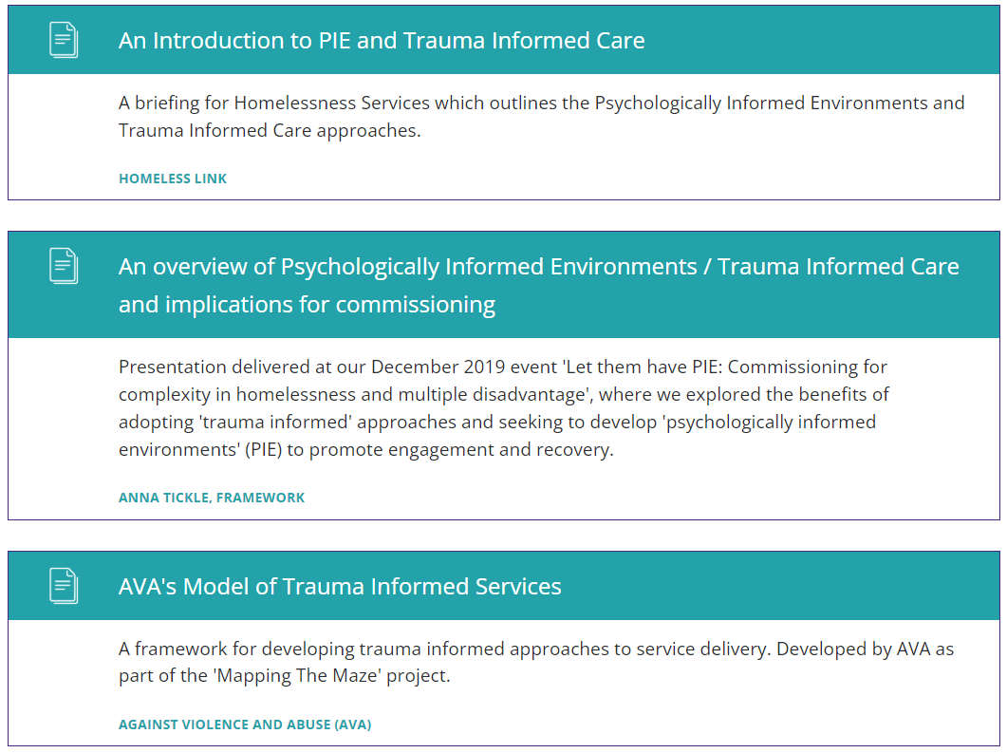

Slide 17
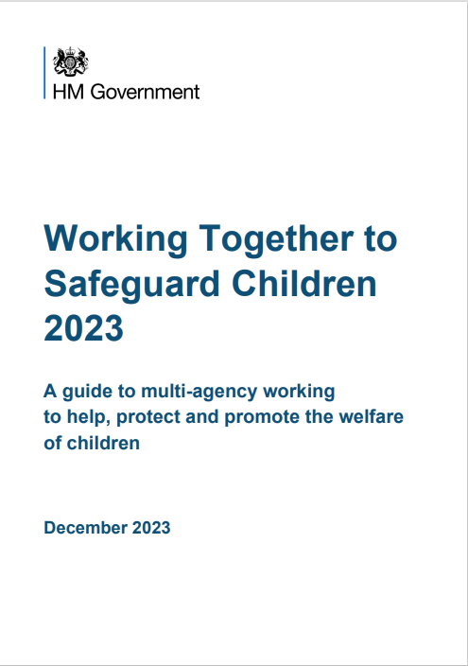
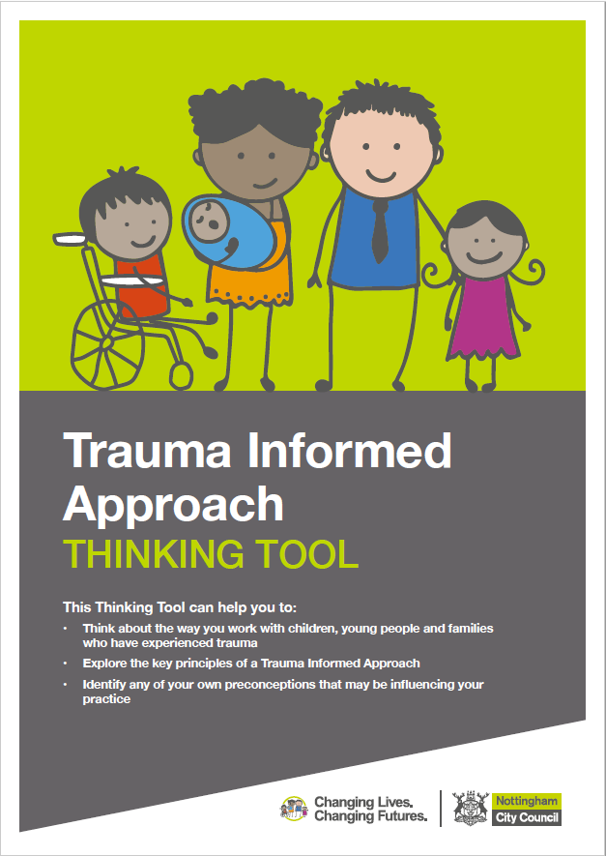
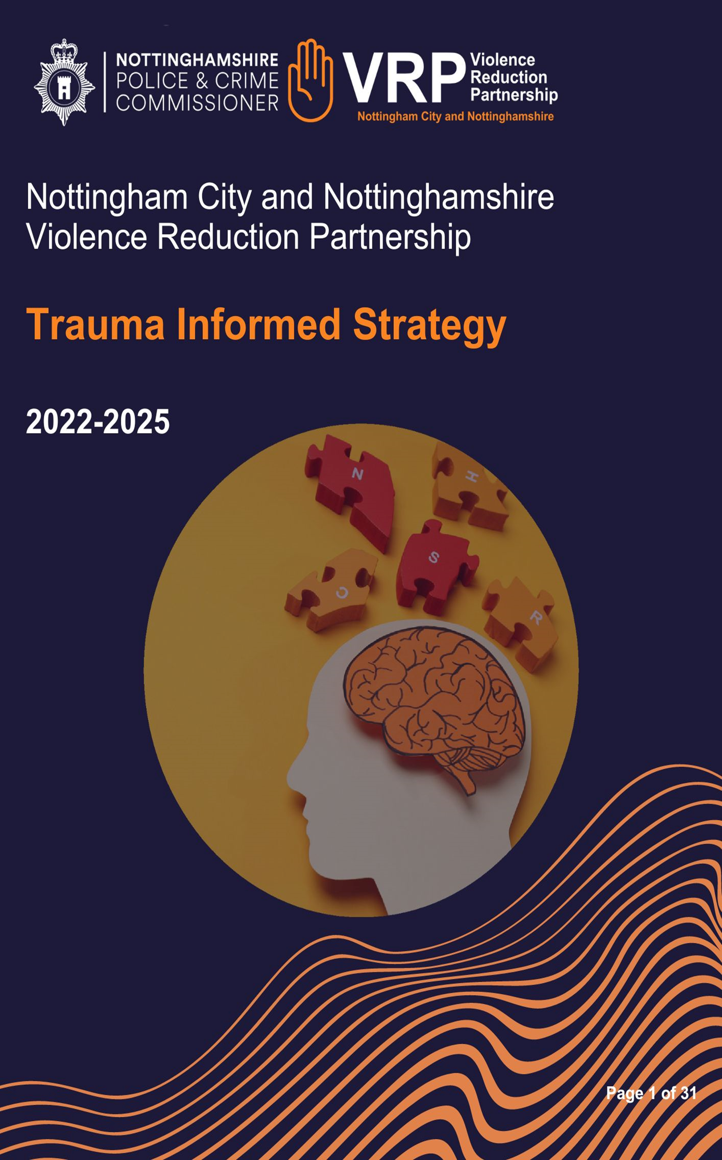

Some key documents

